Slide 1
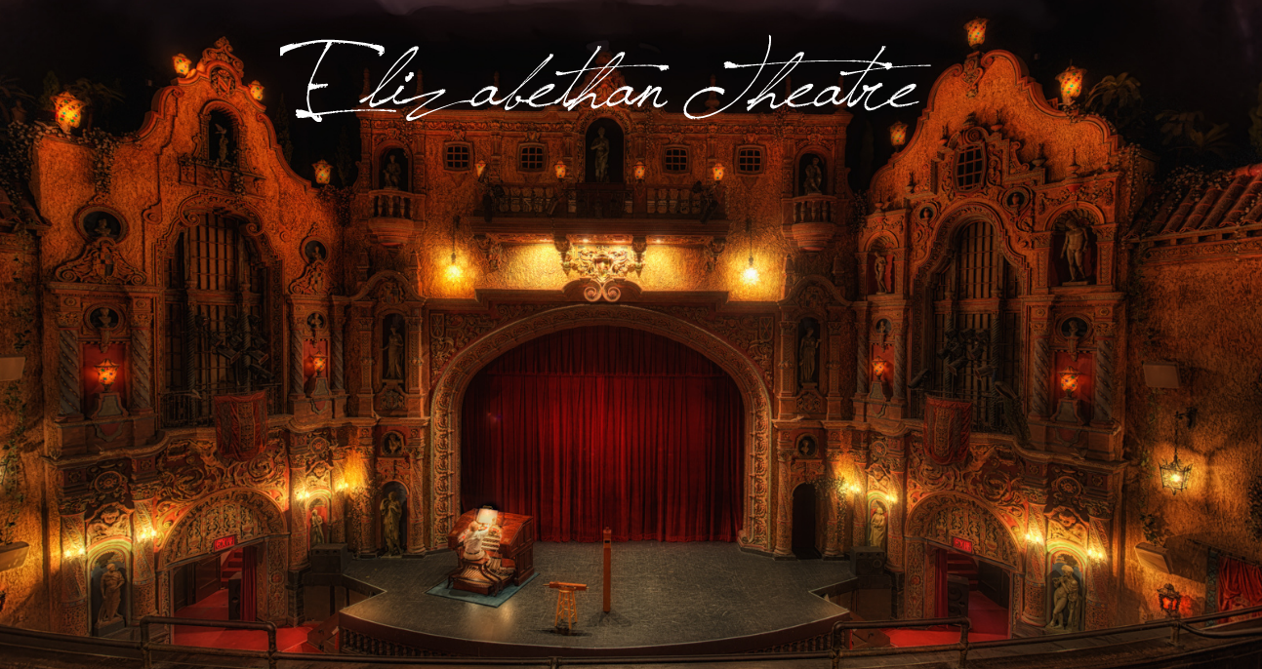
Elizabethan Theatre

Slide 3
Overview
History
The ‘Players’
Noteworthy Playwrights
Types of Elizabethan Theatres

Slide 4
The History
English Renaissance theatre, also known as early modern English theatre, but usually as Elizabethan theatre, is the era of theatre in England between 1562 and 1642.
This is the style of the plays mostly known by the work from William Shakespeare, Christopher Marlowe and Ben Jonson.
English Renaissance theatre encompasses the period between 1562 (the performance at the Inner Temple during the winter of 1561 of Gorboduc, the first English play using blank verse) and 1642 (ban on theatrical plays by the English Parliament).

Slide 5
The establishment of large and profitable public theatres was an important factor in the success of English Renaissance drama. Once they were in use, drama could become a fixed and permanent rather than a passing phase. Their construction was begun when the Mayor and Corporation of London first banned plays in 1572 to help stop the spread of the plague, and then formally expelled all players from the city in 1575. This began the construction of permanent playhouses outside of London, in the towns of Halliwell/Holywell in Shoreditch and later the Clink, and at Newington Butts near the entertainment district of St. George's Fields in rural Surrey.

Slide 6
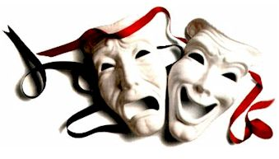
The Players
The Players were simply known as the actors.
All actors were men and young boys, because women were not allowed to act.
Actors would form groups called companies (or the ‘Queen’s Men’) and were sponsored by nobles in order to gain political protection.
They needed to memorize as many as 50 parts for 25 different plays in one month, since plays were rarely repeated.

Slide 7
The Genres
Tragedy was an amazingly popular genre. Marlowe's tragedies were very popular, such as Dr. Faustus. The audiences also really liked revenge dramas, such as Thomas Kyd's The Spanish Tragedy. The four tragedies considered to be Shakespeare's greatest (Hamlet, Othello, King Lear, and Macbeth) were made during this period, as well as many others.
Comedies were common, too. A sub-genre developed in this period was the city comedy, which deals satirically with life in London after the fashion of Roman New Comedy. Examples are Thomas Dekker's The Shoemaker's Holiday and Thomas Middleton's A Chaste Maid in Cheapside.

Slide 8
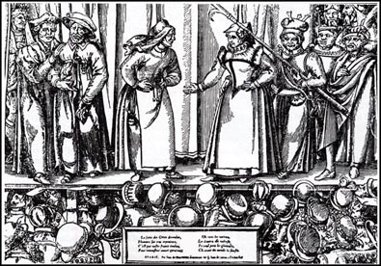
Though smaller, the older genres like pastoral (The Faithful Shepherdess, 1608), and even the morality play (Four Plays in One, ca. 1608-13) could affect people.
After about 1610, the new hybrid sub-genre of the tragicomedy came to infamy, as did the masque throughout the reigns of the first two Stuart kings, James I and Charles I.

Slide 9
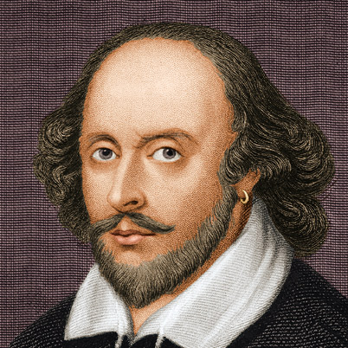
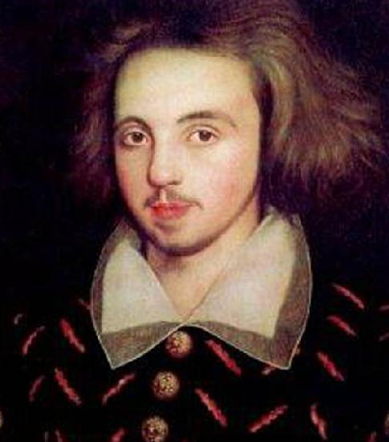
Famous Playwrights
William Shakespeare
(April 26, 1564- April 23, 1616)
-English poet and playwright
-Wrote 38 plays, 154 sonnets and several poems
-Eg. Hamlet, Romeo & Juliet, and Julius Caesar
Christopher Marlow
-(Feb. 26, 1564- May 30, 1593)
-English dramamtist, poet and translator
-Believed to have written 6 plays
-Eg. Doctor Faustus, The Massacre at Paris
-Stabbed to death, unfortunately.

Slide 10
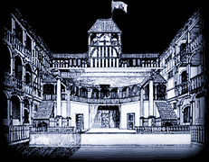
Types of Elizabethan Theatres
Inn Yards- Elizabethan acting troupes travelled the country and sought lodgings at inns or taverns. The troupes often negotiated with the tavern owner, or vintner, in order to do a performance at the inn. So they staged the plays in the inn-yards. The inn-yards were surrounded by balconies which led to the rooms which provided lodgings for travelers.

Slide 11
Open-Air Amphitheatres-They combined their experiences of the inn-yards with other forms of entertainment and produced an amphitheatre. This was created by modifying the features of the existing ‘blood sport rings’ with the addition of a fixed stage, unlike the trestle-supported stage used in the inn-yards. This allowed the stage productions to become far more complicated with the use of props such as canons, trapdoors, and a much larger stage area for the actors. Special effects were also an awesome addition allowing for smoke effects, the firing of a real canon, fireworks and spectacular 'flying' entrances. The other important feature was the cobbled yard, instead of the bare earth floor suited to animals. This allowed the 'pit' area to house the audience, even on wet days.

Slide 12
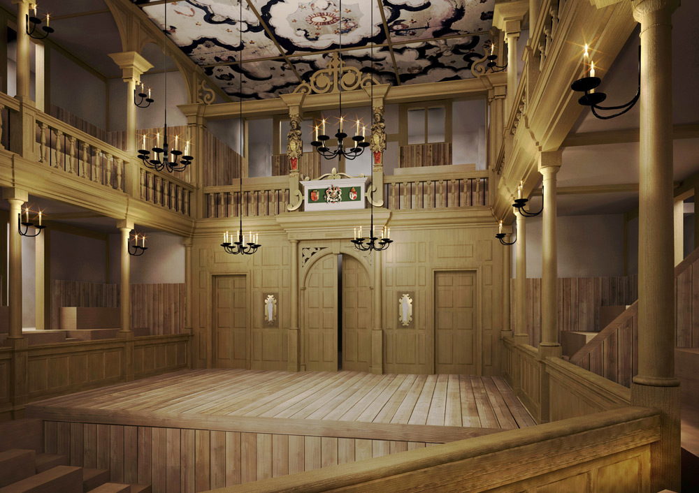
Indoor Playhouse- The playhouses helped the acting troupes considerably as playhouses allowed for an all-year-round profession, not one restricted to the summer. Playhouses also allowed for luxury, comfort and convenience for nobility when watching a play.

